Slide 1
MENTORNESS INTERNSHIP BY md MOHSHIN KHAN
TASK-3(Analysis of Food and Beverage Industry Survey Data)

Slide 2
PROJECT OBJECTIVE
The objective of this Power BI project is to analyze survey responses from the food and beverage industry to gain insights into consumer behavior, preferences, and perceptions. The analysis will help identify key trends, understand brand perception, and explore potential areas for improvement in product offerings and marketing strategies.

Slide 3
DATA DESCRIPTION
Fact Table: fact _ survey _ responses
• Response _ ID: Unique identifier for each survey response.
• Respondent _ID: Unique identifier for each respondent.
• Consume _ frequency: Frequency of consumption of food and beverage products.
• Consume _ time: Typical time when the products are consumed.
• Consume _ reason: Reasons for consuming the products.

Slide 4
• Heard _ before: Whether the respondent has heard of the product before.
• Brand _ perception: Respondent's perception of the brand.
• General _ perception: Overall perception of the food and beverage industry.
• Tried _ before: Whether the respondent has tried the product before.
• Taste _ experience: Respondent's experience with the taste of the product.
• Reasons _ preventing _ trying: Reasons preventing respondents from trying the product.
• Current _ brands: Brands currently consumed by the respondent.
• Reasons _ for _ choosing _ brands: Reasons for choosing specific brands.
• Improvements _ desired: Improvements desired in products.
• Ingredients _ expected: Expected ingredients in products.
• Health _ concerns: Health concerns related to products.
• Interest _ in _ natural _ or _ organic: Interest in natural or organic products.
• Marketing _ channels: Preferred marketing channels for product information.

Slide 5
• Packaging _ preference: Preferences for product packaging.
• Limited _ edition _ packaging: Interest in limited edition packaging.
• Price _ range: Preferred price range for products.
• Purchase _ location: Typical locations where products are purchased.
• Typical _ consumption_ situations: Common situations in which products are consumed.

Slide 6
Dimension Table: dim _ respondent
• Respondent _ ID: Unique identifier for each respondent.
• Name: Name of the respondent.
• Age: Age of the respondent.
• Gender: Gender of the respondent.
• City _ ID: Identifier linking the respondent to a city.

Slide 7
Dimension Table: dim _ cities
• City _ ID: Unique identifier for each city.
• City: Name of the city.
• Tier: Tier classification of the city (e.g., Tier 1, Tier 2).

Slide 8
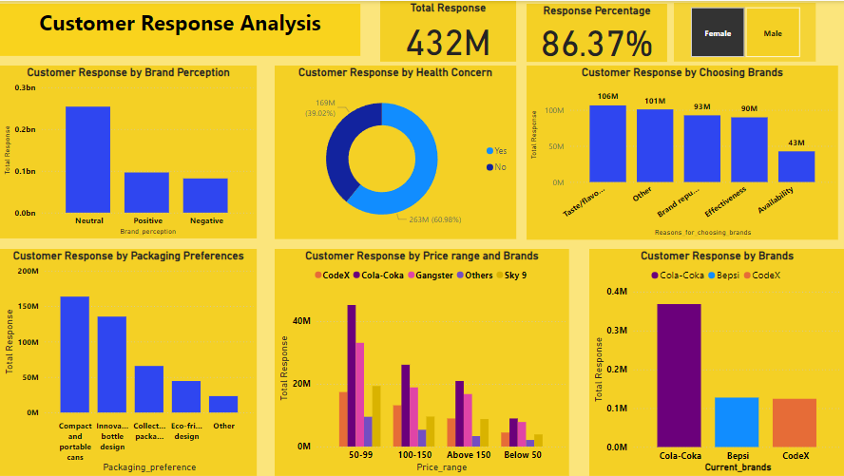

Slide 9
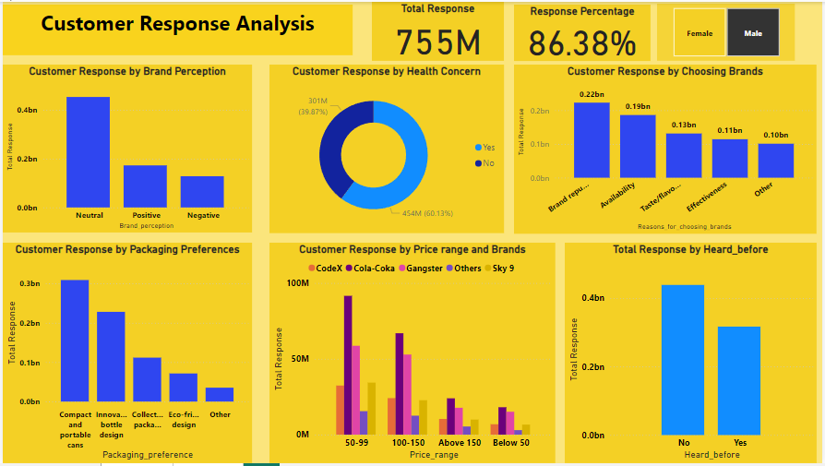

Slide 10
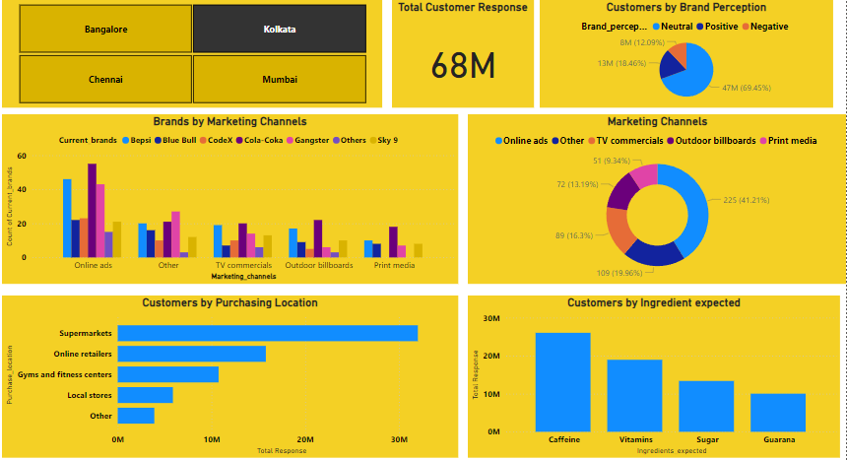

Slide 11
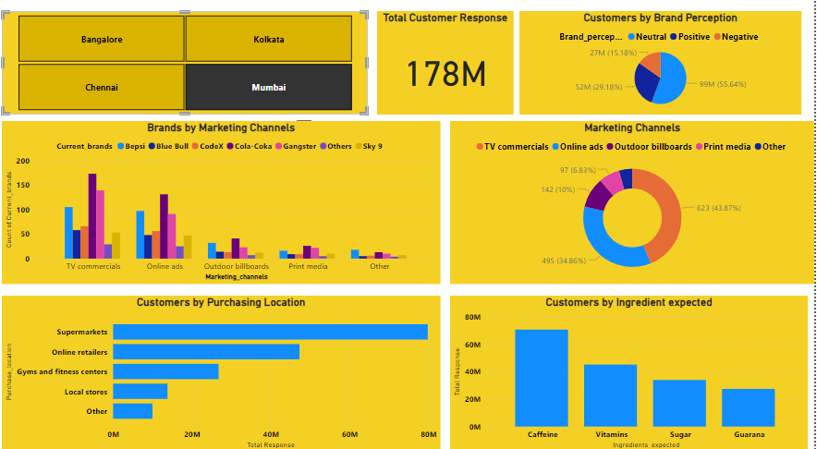

Slide 12
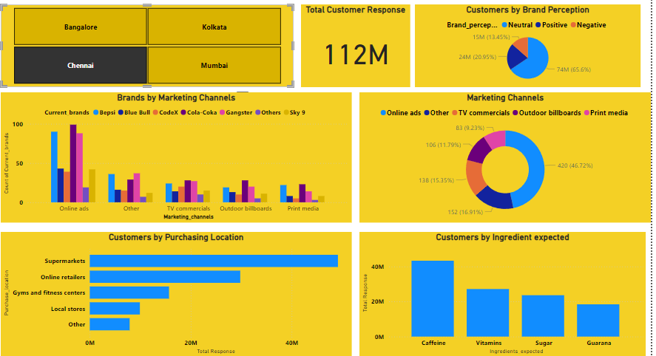

Slide 13
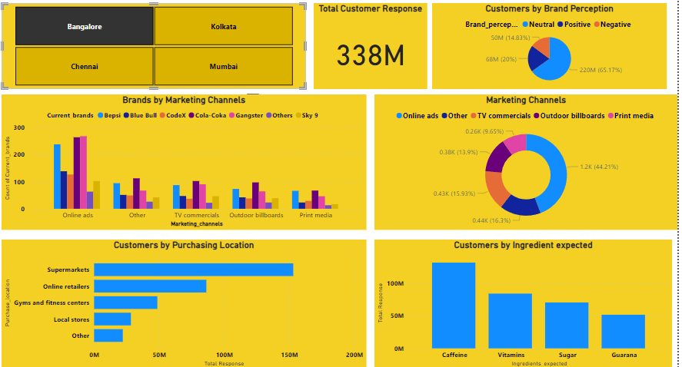

Slide 14
Conclusion
Total customer response is 86%.
Customer brand perception is neutral.
60% customers are health concern and 40% customers are not health concern.
Most customers choose brands because of its reputation.
Customers packaging preferences is Compact and Portable Design.
Customers prefered Cola-Coka over price range.
Top three brands preferred by customers are Cola-Coka,Bepsi and CodeX.
Most customers buy their brands from Supermarket.
In different marketing channels Cola-Coka has highest number of marketing channels from others brands.

Slide 15
Bangalore has highest number of response of 338M.
Mumbai has maximum marketing channels from TV commercials.
Kolkata , Chennai, and Bangalore has maximum marketing channels from Online Ads.
Bangalore has highest number of customers that buy from Supermarkets

